Slide 1

Lost and Found Management System

Slide 2
The project Lost and Found Management System is aimed at automating the process of reporting, tracking, and managing lost and found items within the university.
Table of contents
Problem Statement
Context Diagram
Data Flow Diagrams
ER Diagrams
Use Case Diagram
User Case Diagram
SRS

Slide 3
Problem Statement
In large organizations like universities, the manual process of reporting, tracking, and returning lost items is highly inefficient. This leads to:
Ineffective Matching: Lost and found records are managed separately, making it difficult to reconnect items with their rightful owners.
Time-Consuming Processes: Manual logbooks and informal communication cause delays and increase administrative workload. Lack of Centralized Tracking: Absence of a unified system leads to confusion, data loss, and low recovery rates of belongings.

Slide 4

SOFTWARE REQUIREMENT SPECIFICATION

Slide 5
1.1 PURPOSE
The purpose of this project is to create a Lost and Found Management System that makes it easier for people to report lost items and register found ones. Instead of depending on manual logbooks or word-of-mouth, this system provides a single, organized platform where everything can be tracked in one place.
By reducing confusion and delays, the system helps ensure that lost belongings are returned to their rightful owners quickly and efficiently.

Slide 6
1.INTRODUCTION
The Lost and Found Website is an online platform designed to help users report, search, and recover lost or found items in an efficient and organized manner. It allows individuals to post details such as item description, date, location, and photos, while also enabling others to browse or search for matching reports. The system aims to bridge the gap between people who lose belongings and those who find them, making the recovery process faster, more reliable, and user-friendly, while also providing administrators with tools to monitor and manage reports effectively.

Slide 7
1.2 SCOPE
The Lost and Found Management System provides a centralized platform where users can report lost items, register found items, and claim belongings. Admins will verify records, manage duplicates, and track claims to ensure accuracy. The system will also maintain history for transparency and faster recovery.
This project is intended for use in organizations such as universities, offices, and campuses, where large numbers of people make manual tracking difficult. By digitizing the process, the system reduces dependency on physical logbooks, minimizes errors, and saves time for both users and administrators.

Slide 8
2. OVERALL DESCRIPTION
The Lost and Found Management System provides a digital platform to report lost items, register found items, and manage claims. Admins verify records, remove duplicates, and track item history to ensure accuracy and transparency. By replacing manual logbooks with an organized system, it reduces errors, saves time, and improves the chances of reuniting belongings with their rightful owners.
The system is designed to be user-friendly, secure ,and efficient, making it suitable for large organizations such as universities, offices, and campuses. It ensures proper record-keeping, minimizes administrative workload, and provides quick access to information whenever required.

Slide 9
2.1 USER INTERFACES
Login screen for entering the username, password, type of user (Administrator, Data entry operator, student, teacher) will be provided. Access will be based upon the role of user.
A screen to search and view lost and found items will be available.
A screen to report lost or found item will be there.

Slide 10
2.2 HARDWARE INTERFACES
Processor: Intel Pentium IV processor or above with minimum 2 GHz speed.
RAM: Minimum 1 GB.
Hard Disk: Minimum 20 GB of free space.
Input Devices: Standard keyboard and mouse.
Output Devices: Standard monitor with minimum resolution of 1024x768.

Slide 11
2.3 SOFTWARE INTERFACES
Visual Studio 2010
Service Pack2 for Windows XP/VISTA
DB Server: SQL SERVER 2008
OS:Window Vista/XP/7

Slide 12
2.4 OPERATIONS
The DBA at client side will be responsible for manually deleting old/non required data. Database backup and recovery will also be handled by the DBA.
The system will provide a RESET SYSTEM function
that will delete all existing information from the database.

Slide 13
2.5 PRODUCT FUNCTIONS
Depending upon the user role he/she will be able to access only the specific modules of the system
Login Facility for enabling only authorized access to the system.
User (with role of Finder/Reporter)will be able to add/modify/delete information regarding items they have reported as lost or found.

Slide 14
User (with role of Administrator) will be able to manage all records in the system, including verifying reported items, matching lost items with found ones, and resolving disputes. They can also create/modify/delete user accounts.
User (with role of General User/Seeker) will be able to search for lost or found items and view matched results but cannot modify or delete other users’ records.

Slide 15
2.6 USER CHARACTERISTICS
Users of the Lost and Found System will be required to follow a security policy to ensure that information related to reported items is not altered or misused by unauthorized individuals (such as gaining direct access to the backend database).
Users are expected to have basic computer literacy (ability to log in, search, and enter details of items).
Different roles (General User, Finder/Reporter, Administrator) will have different levels of access rights, and each must operate strictly within their role boundaries to maintain system integrity.

Slide 16
2.7 ASSUMPTIONS AND DEPENDENCIES
It is assumed that all users (students, staff, administrators) will have valid login credentials to access the system.
It is assumed that users will provide accurate and truthful information while reporting lost or found items.
The system assumes that administrators will actively monitor and verify records to prevent misuse or false reporting.

Slide 17
3. FUNCTIONAL REQUIREMENTS
User Authentication: Users login with User ID, Password, and Role. Access to modules is restricted by role (Admin, Finder/Reporter, General User).
Lost & Found Management: Users (Finder/Reporter) can add, edit, or delete lost/found item records with details (ID, Name, Description, Date, Location).
Search & Match: Users can search items by name, date, or location. The system auto-generates possible matches and updates status (Pending, Returned, Closed).
User Account Management (Admin): Admin can create, update, or delete user accounts with details (User ID, Name, Password, Role).

Slide 18
4. NON-FUNCTIONAL REQUIREMENTS
Security – Password protection & role-based access.
Usability – Simple and user-friendly interface.
Reliability – Accurate data and consistent performance.
Performance – Fast search results, supports multiple users.
Maintainability – Modular design for easy updates.
Portability – Works on desktops, laptops, and mobiles.

Slide 19
5.1 EXTERNAL INTERFACES
The following screens will be provided:
Login Screen
This will be the first screen displayed. It allows users to access different screens based upon their role.
Various fields available on this screen will be:
User ID: alphanumeric of length up to 10 characters.
Password: alphanumeric of length up to 10 characters.
Role: Will have the following values: Administrator,
Finder/Reporter, General User.

Slide 20
5.1 EXTERNAL INTERFACES
Lost Item Report Screen
This screen will be accessible only to users with the role Finder/Reporter.
It will allow the user to enter details of an item they have lost.
Fields available:
Item ID: auto-generated unique identifier.
Item Name: only alphabetic letters, length up to 40 characters.
Description: alphanumeric text, length up to 200 characters.
Date Lost or Found: format DD/MM/YYYY.
Location Lost or Found: only alphabetic letters, length up to 50 characters.

Slide 21
5.1EXTERNAL INTERFACES
Search Item Screen
This screen will be accessible to all users (General User, Finder/Reporter, Administrator).
It will allow users to search for lost/found items.
Search can be performed based on parameters such as:
Item Name
Date Lost/Found
Location

Slide 22
5.2 SYSTEM FEATURES
.
The system will maintain information about items reported as lost and found, including Item ID, Item Name, Description, Date, and Location. It will allow creation, modification, and deletion of these records.
The system will provide a search and matching facility to help users find potential matches between lost and found items.
The system will maintain user accounts with roles(Administor, Finder/Reporter, General User) and allow role-based access to different modules.

Slide 23
5.2 SYSTEM FEATURES
Validity Checks:
Only authorized users access system modules.
Each Item ID and User ID is unique.
Mandatory fields are not left blank.
Status for Items take valid values: Pending, Return and closed.

Slide 24
5.3 ITEMS INFORMATION MAINTENANCE
The system will maintain information about items that are reported as lost or found. The following information will be maintained: Item ID, Item Name, Description, Date, Location, and Status.
The system will allow creation, modification, and deletion of records by the reporting user. The administrator will have the authority to verify and manage these records.

Slide 25
5.3 ITEMS INFORMATION MAINTENANCE
Validity checks:
Only authorized users (Finder/Reporter, Administrator) will
be able to add or modify item information.
Item ID will be unique for each record.
Item Name,Date and Location cannot be left blank.

Slide 26
5.4 USER ACCOUNT INFORMATION MAINTENANCE
A system will maintain information about various users who will be able to access the system.The following information would be a maintained: User name, user ID, Role and Password.
Validity checks:
Only authorized users (Finder/Reporter, Administrator) will be able to add or modify item information.
Item ID will be unique for each record.
Item Name,Date and Location cannot be left blank.

Slide 27
5.5 SOFTWARE SYSTEM ATTRIBUTES
Security: The application will be password protected.Users must provide correct login credentials to access the system. Role-based access will restrict modules to authorized users only.
Maintainability: The application will be designed in a modular and maintainable manner, making it easy to incorporate new requirements or enhance existing modules (e.g., adding new search filters or notification features).
Portability: The application will be easily portable and can run on different platforms (desktop, laptop, or mobile devices) with a standard web browser and internet connection.

Slide 28
5.6 LOGICAL DB REQUIREMENTS
The following information will be placed in DB:
Item Information: Item ID, Item Name, Description, Date Lost/Found, Location and Status.
User Account Information: User ID, User Name, Password, Role.
Lost Report Information: Report ID, Item ID, Reporter ID, Date of Report.
Found Report Information: Report ID, Item ID, Finder ID, Date of Report.
Match Information: Lost Item ID, Found Item ID, Match Status (Pending, Returned, Closed).

Slide 29
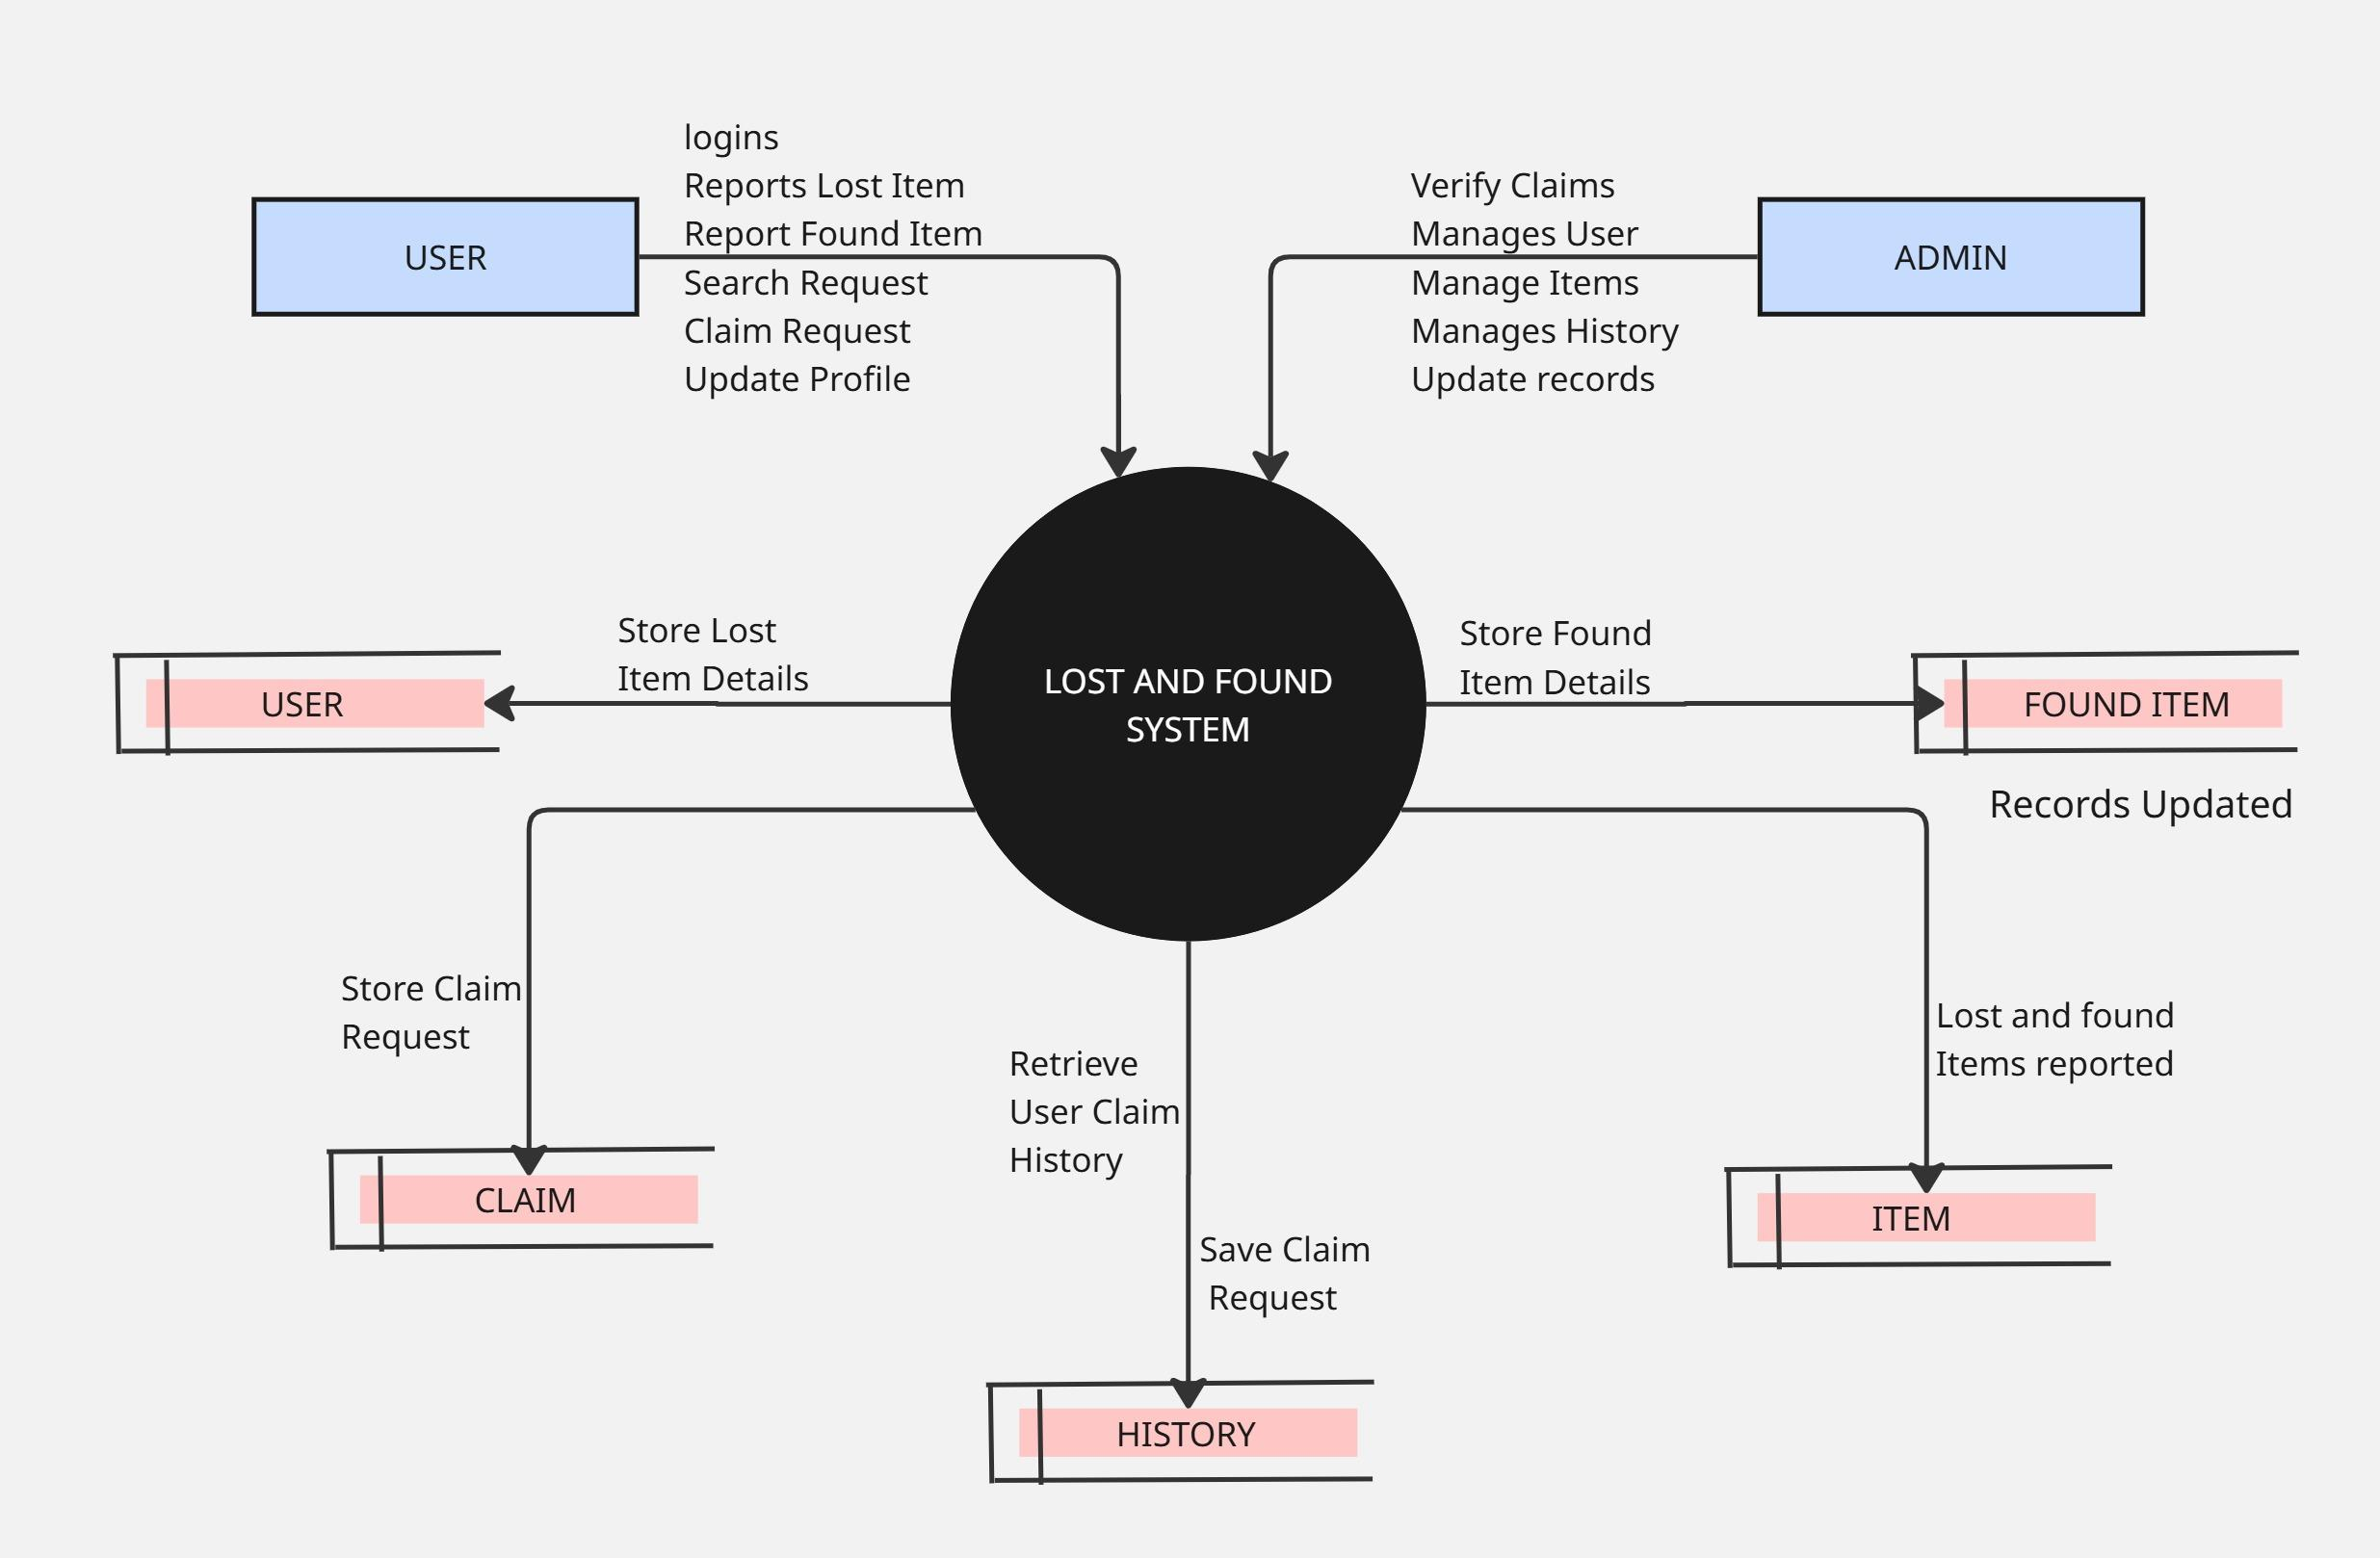
Context Diagram

Slide 30
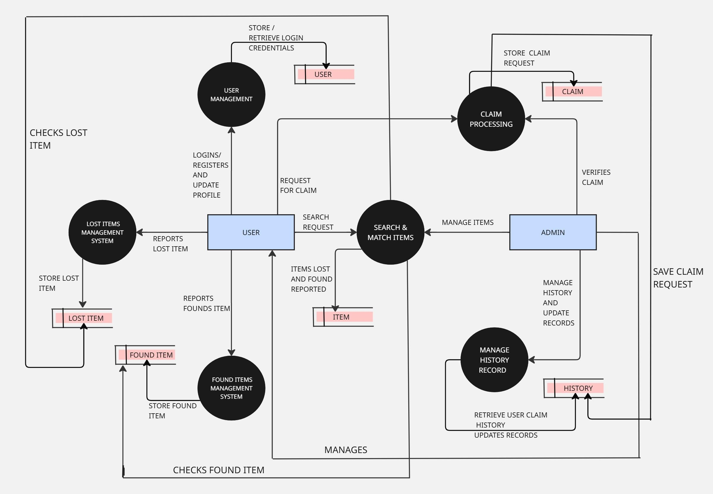
Level-1 DFD

Slide 31
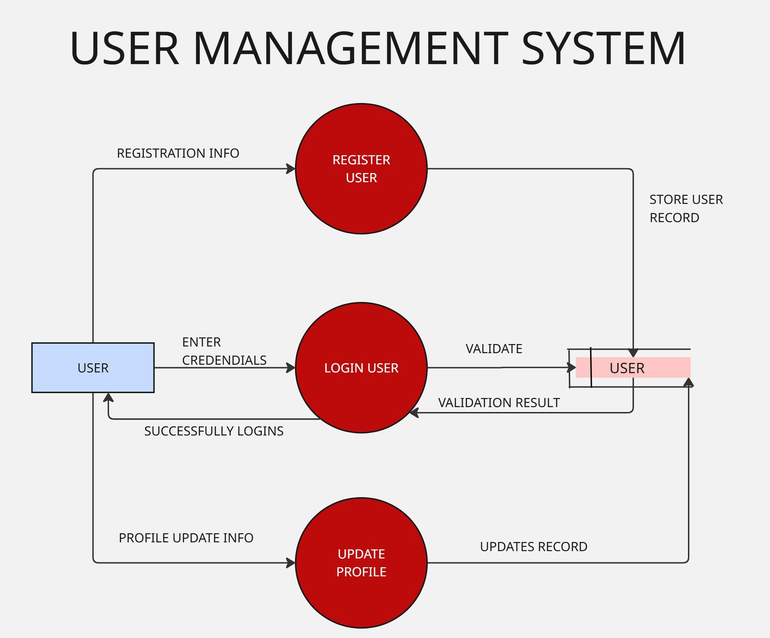
Level-2 DFD

Slide 32
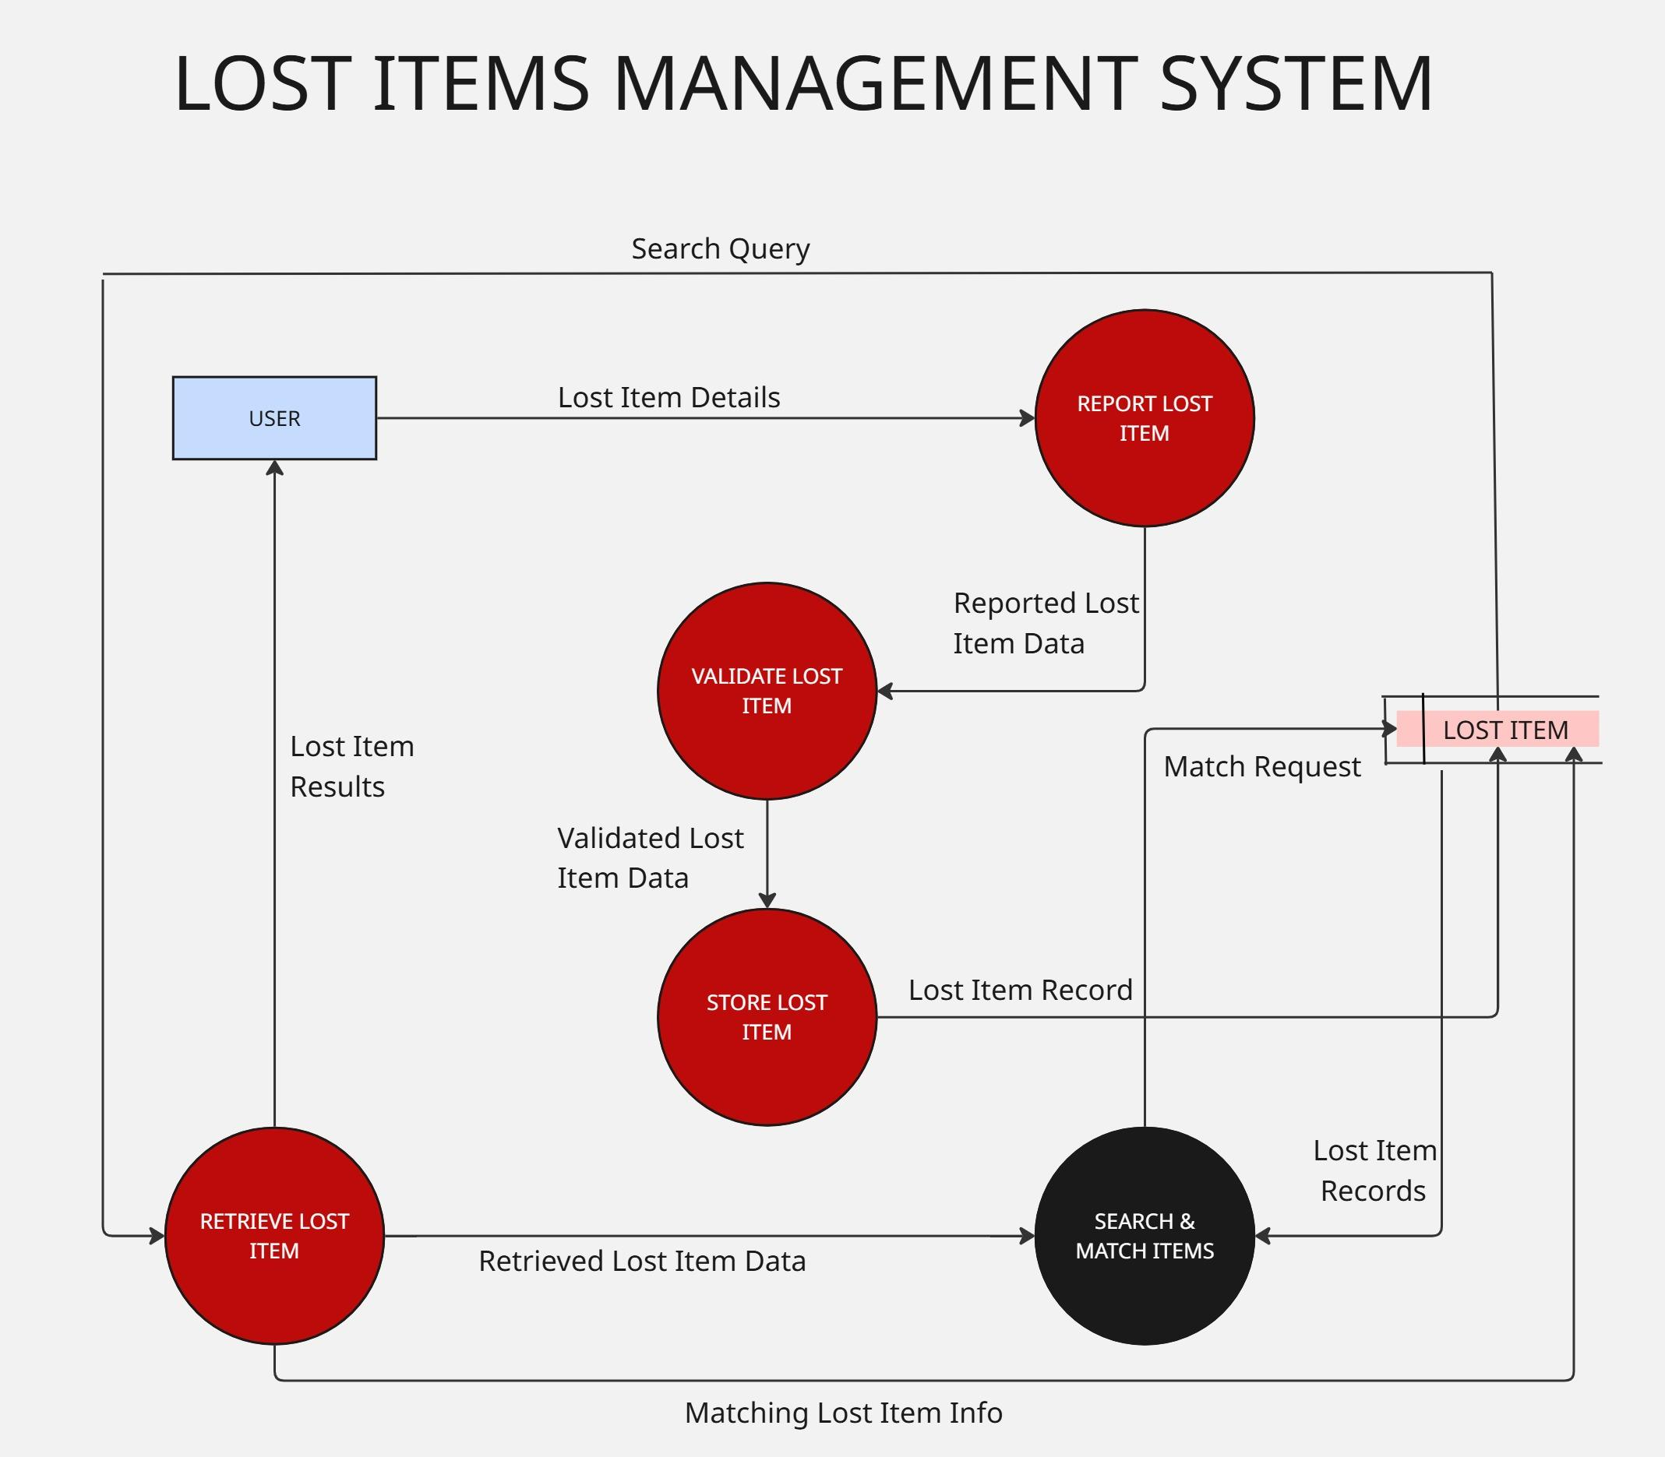

Slide 33
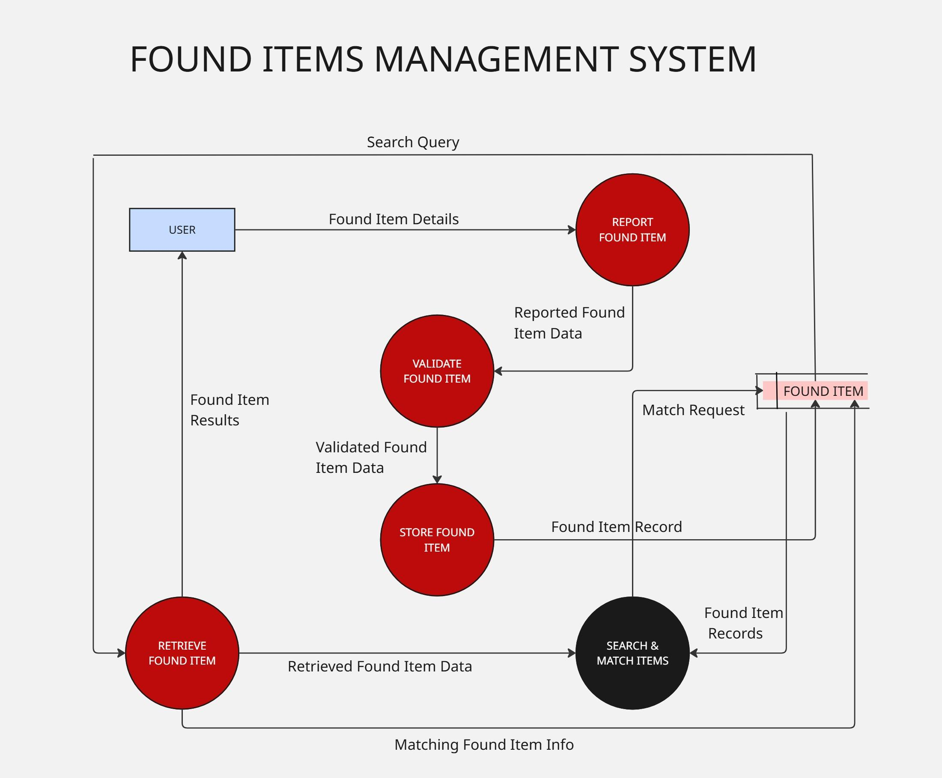

Slide 34
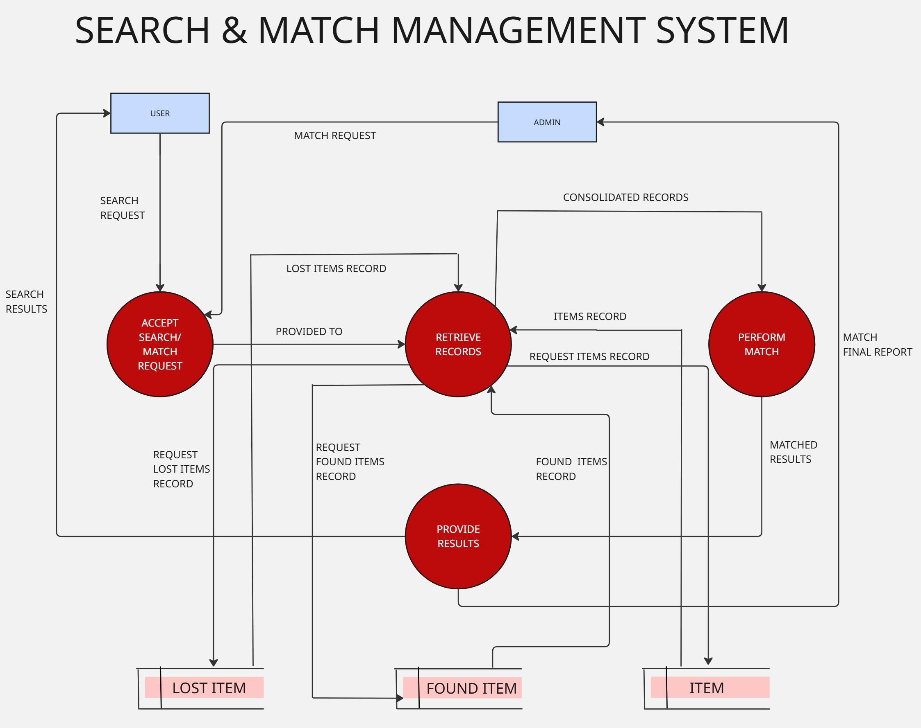

Slide 35
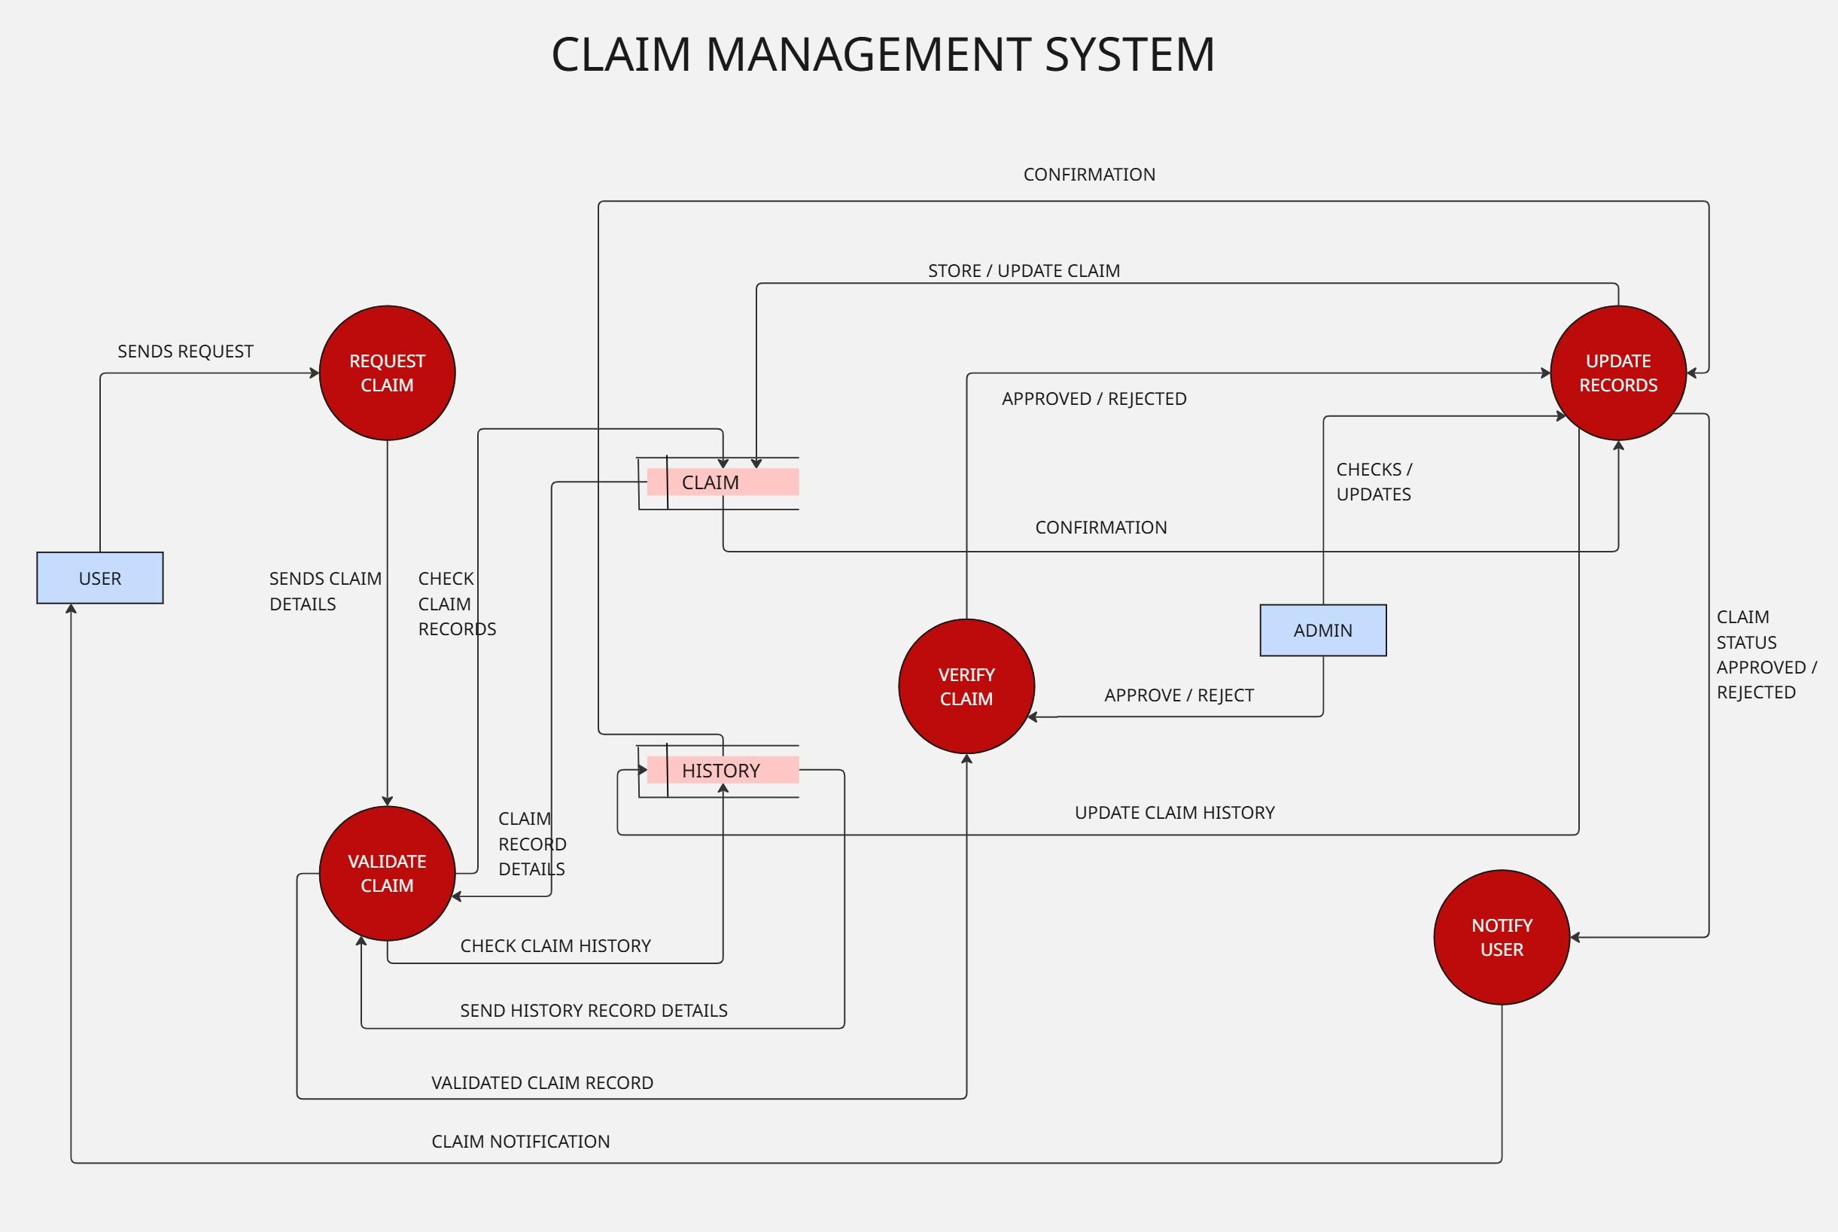

Slide 36
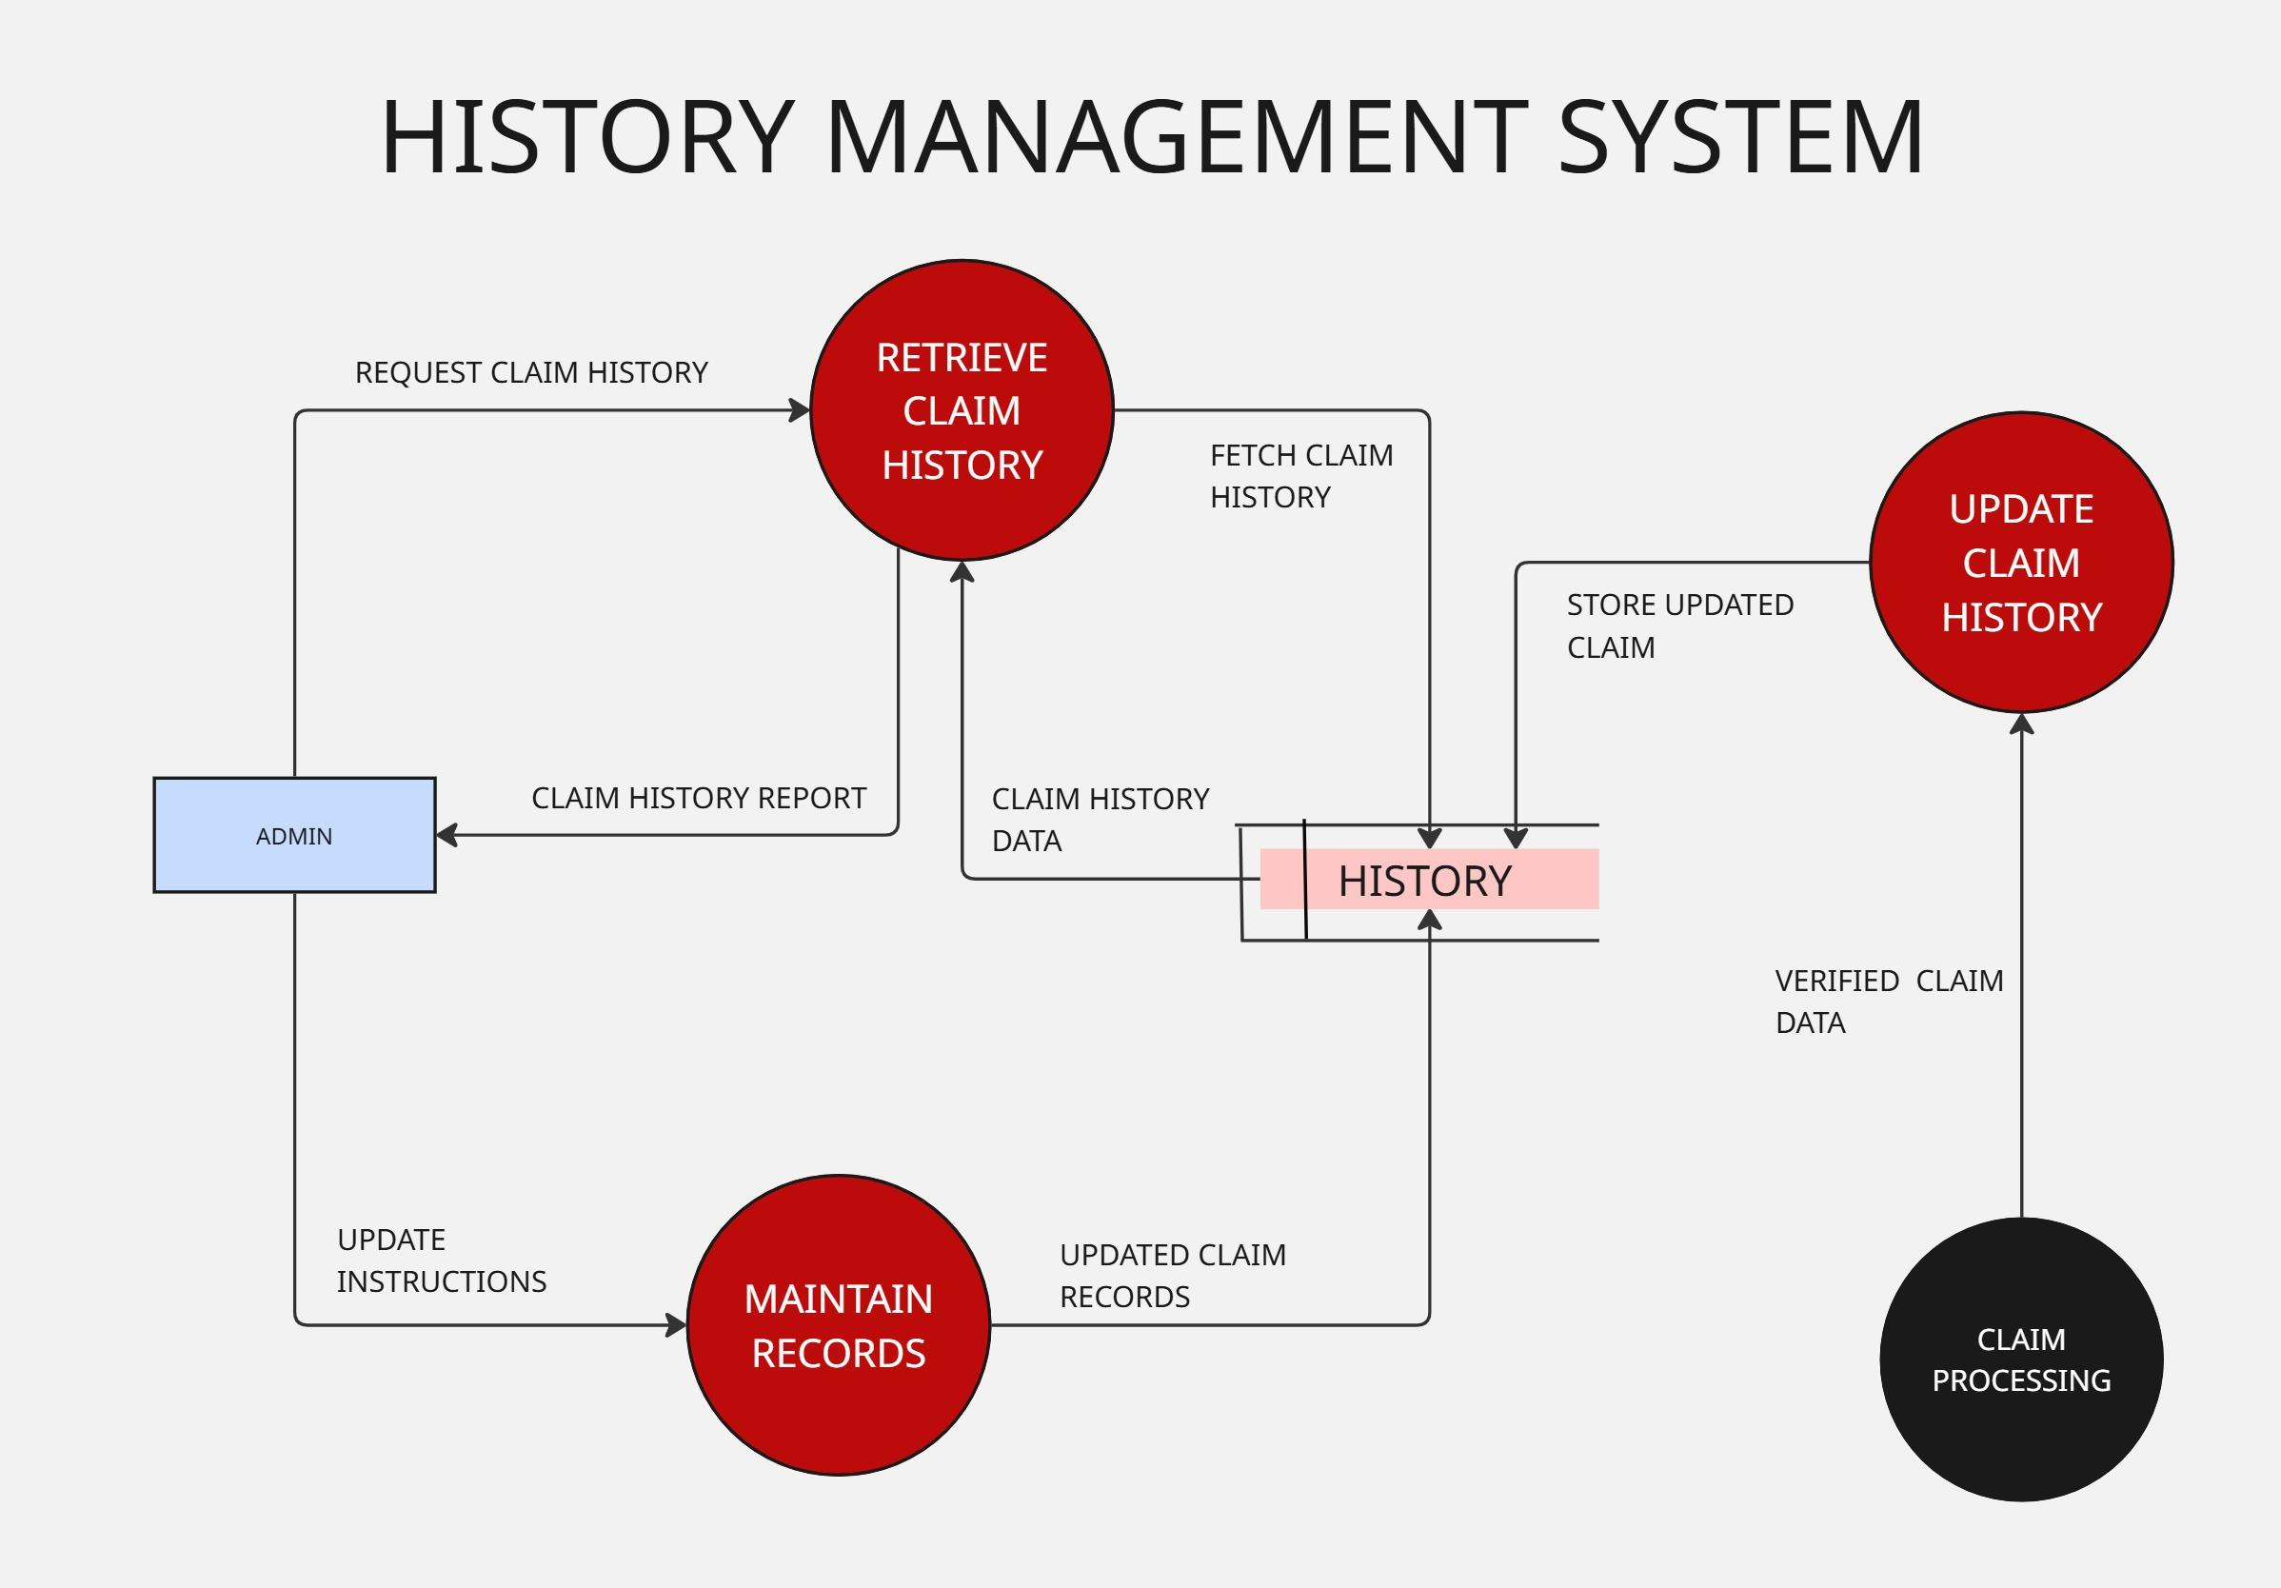

Slide 37
Use Case

Slide 38
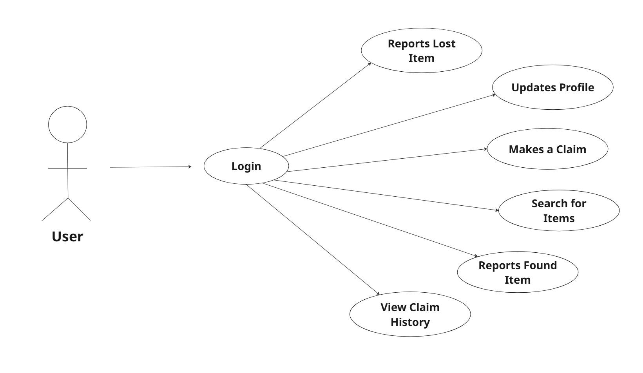
USE CASE DIAGRAM

Slide 39
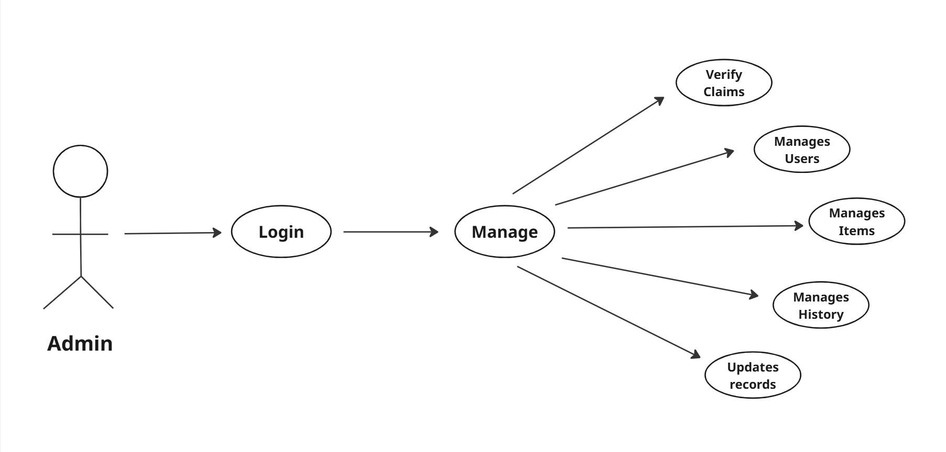

Slide 40

USER CASE DIAGRAM

Slide 41
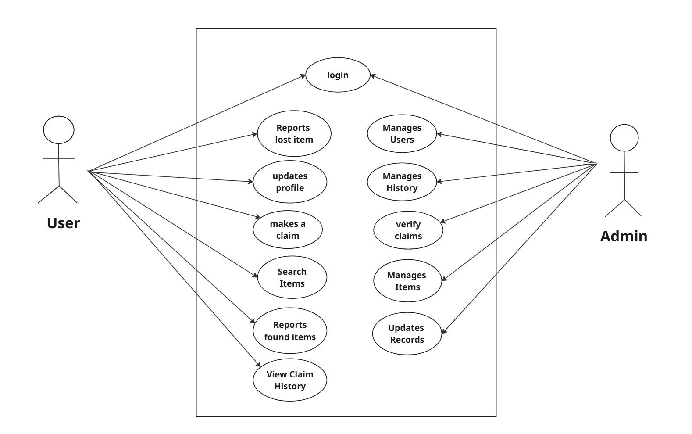

Slide 42
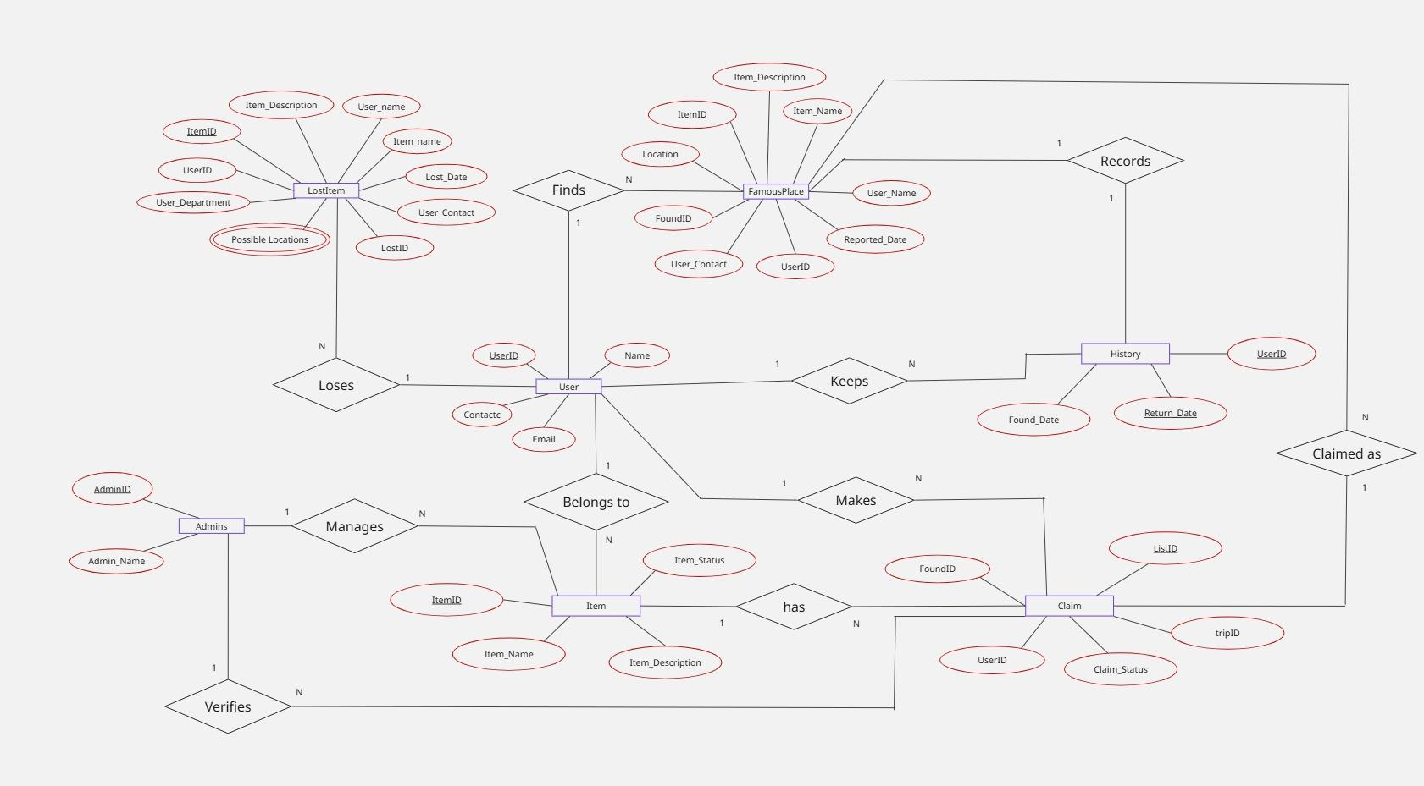
ER DIAGRAM

Slide 43




